Slide 1
Piney Branch Elementary
PTO
MEETING
January 15, 2025

Slide 2
Motion to Open
November Meeting Minutes
Today's Agenda
Upcoming Events
Committee Updates
Staff Appreciation
Yearbooks
Winter Dance
Family Heritage Festival
WATCH D.O.G.S.
Wednesday, January 15, 2025
Fundraising Goals
Financial Review
Open Questions & Discussion
Motion to Close

Slide 3
Motion to Open

Slide 4
Opening Remarks

Slide 5
November Meeting Minutes
Attendees: Attendees: Chris Galegos, Stephanie Davis, Sara Agne, Susie Bacus, Steve Thorne, Monica Sobers, Mrs. Johnson Reeves, Ivette Ornelas, Latoya Biggers, Trish Hilton
October Meeting Minutes - Approved
Color Craze
$17,521 donated
Top Earners were notified
Wednesday, December 4th - Winners Pizza Party
Winners or Ms. Edwards Pizza Party (December 10th)
Stuffed Crust Pizza Requested
Square 1 Art Fundraising Event
- Last day is tomorrow for the fundraiser
- 2k a week ago, 4k today in total sales (11/20)
- If you don’t order by deadline, you can still submit and order things on your own. They
just aren’t guaranteed to be here by the holidays.
- Deadline is 11:59pm
- PBES will get 33% profit from the sales
- Huge Shout Out to Ms. Noland – Thank You to Ms. Noland

Slide 6
November Meeting Minutes
Upcoming Events
Winter Spirit Night
Haymarket Iceplex - December 14th 6-7:30pm
PTO will earn a portion of admission sales
Winter Dance & Events
Spring Bingo - March 21st
- Mr. Thorne to confirm
Musical 3-5th
- PTO will work with Ms. Nichols for ticket sales
Heritage Night
- Helping administration to do a passport project with the kids
- Any kid who collects all the stamps gets a prize from their teacher
5th Grade Promotion Party toward end of May to not interfere with testing
- Trish and Tracy will take the lead
- Planning volunteers have already been established

Slide 7
November Meeting Minutes
Spring Enrichments
- May poll parents to see if there is interest in spring session
Spirit Wear Items Available
We have a few pieces of spirit wear left overall, different sizes. These will be on the website to
be promoted and sold. These items will be in the newsletter and website.
Winter Dance Committee
Jamie Whitaker is Dance Chair
- Decided on Carnival Theme
- Tickets will go on sale December 9th, there will be a limited supply.More information to
come on party packs soon.
- Usually the party packs include tickets, fun themed items
- Student must be accompanied by a parent/guardian
- 600 people MAX.
Staff Appreciation
- Cookie Exchange in December TBD
- Everything on the Amazon wish list has been purchased for cocoa and coffee
- Text went out and 20 minutes later everything was purchased
- Next newsletter, please say thank you to the community.
Yearbooks
January 1st the yearbook will have more information about ordering, photos, and committee.
WATCH D.O.G.S.
- Any 2 days will work, just not 2 dads on same day. Sign up genius will be updated in
December for dates in January.

Slide 8
November Meeting Minutes
Open Questions & Discussion
Administration
- Call backs for the musical will wrap up
- Over 100 kids will be in the musical, she has it all figured out.
- There will be a cultural sing along
- Budgets, VA literacy Act audit went well
- Teachers are handling the changes well
- Teacher of the year nomination - through the county
- Voting happens within the school
- Prince William chatter about data centers that Piney Branch was involved in. Decibel
concerns, Mr. Thorne advises that the cafeteria is much louder than the data center.
- Scholarship students for the winter dance, Ivette will give us a final count of those
needed.
- Ivette will give rough count by end of week
- Increase in need of students.
- Giving Tree still has a few spots open in the office - PTO can add to the newsletter
Motion to Close - Seconded Closed
Facebook Page
- NEW Facebook page is live, join now to be updated!
Fundraising Goals
- Musical scripts, staff stipends, assemblies, end of year celebration
- The Lion King Jr.
Financial Review
Beginning of year fundraising
$12k came in color craze, fall bingo, silent auction
Debits - purchased musical script
40K put aside for playground shade
Money set aside for teaching stipends and other events.

Slide 9
Upcoming Events
Winter Dance : Jan 24
- Spring Bingo : Tentative March 21st
- Musical : Apr 3-5
- Heritage Night : Feb 19th
- 5th Grade Promotion Party : TBD May
- Spring Enrichments TBD
- End of Year Celebration TBD

Slide 10
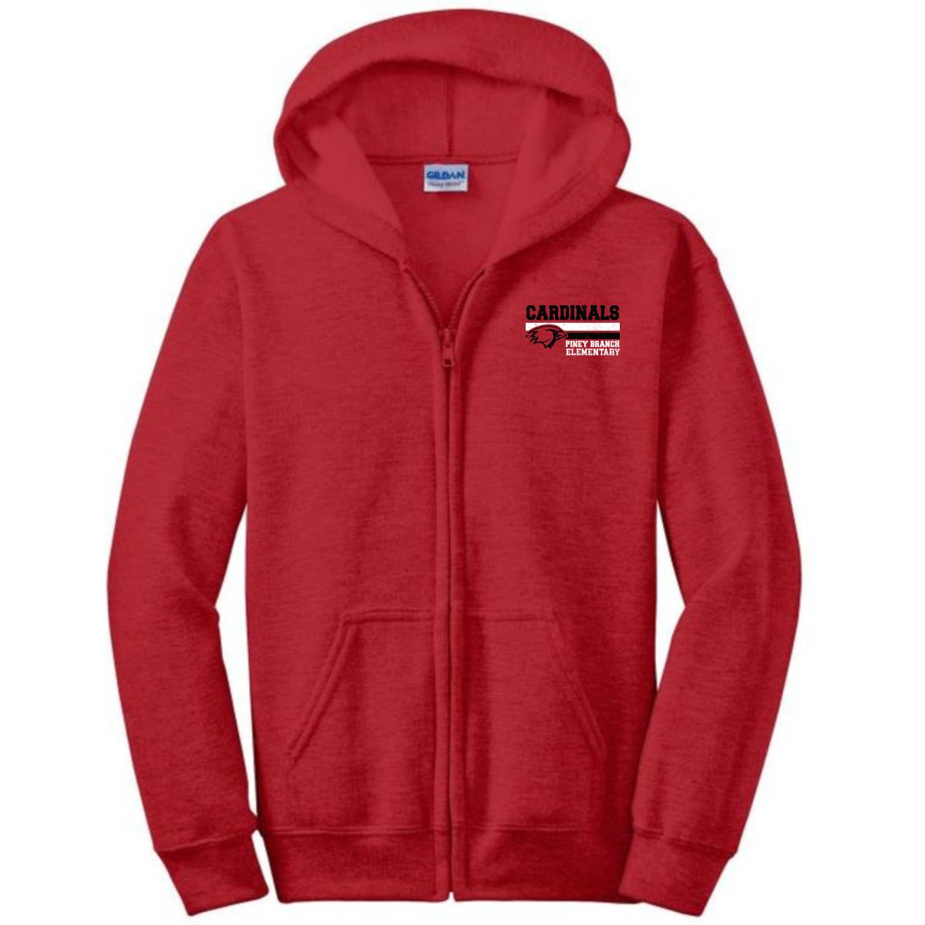
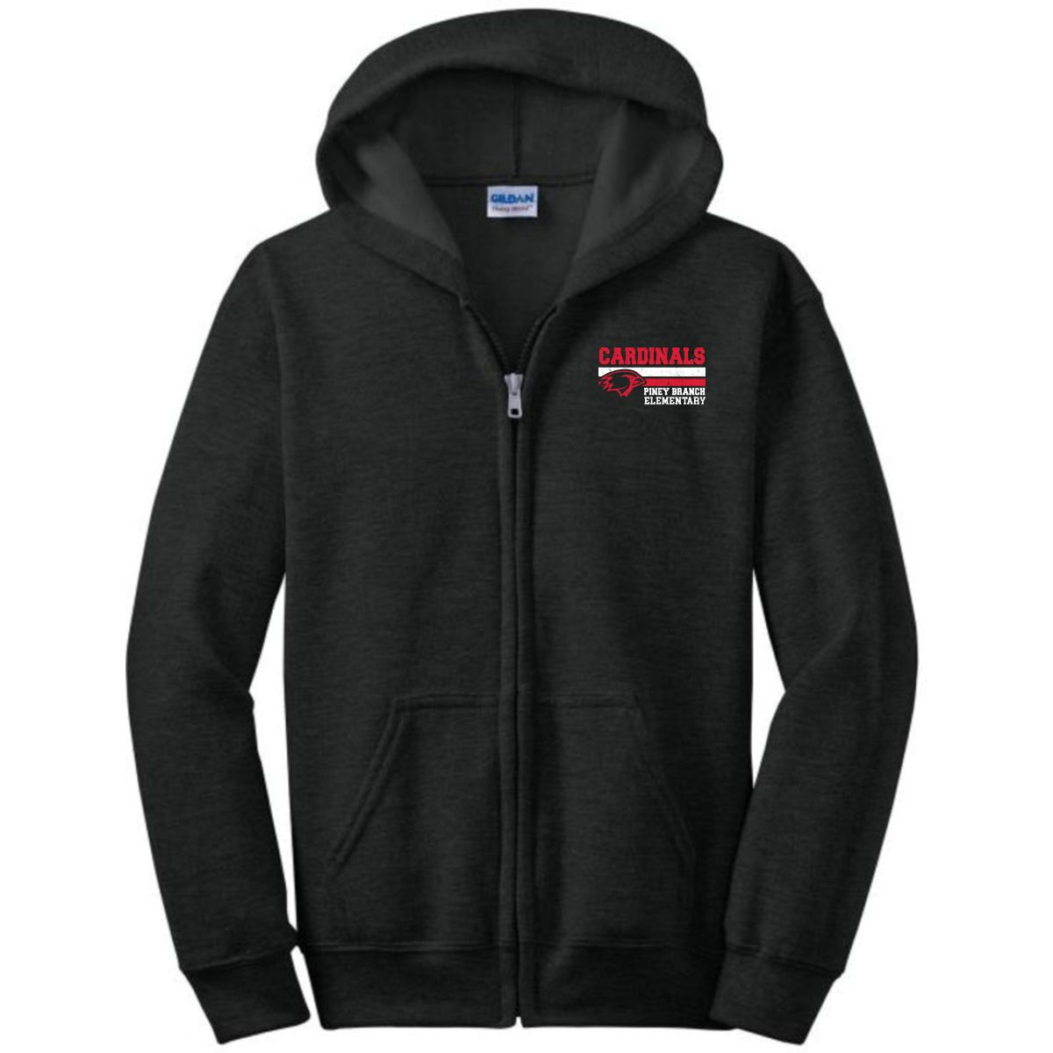
Spirit Wear Items Still Available!

Slide 11
Committee Updates
Staff Appreciation
Please check out the Amazon Wish List on our Facebook page to see how you can help!

Slide 12
Committee Updates - Yearbook
Celina Gallegos will be spearheading the Yearbook committee this year.
If you would like to Volunteer, please email here:
yearbookpbes@gmail.com

Slide 13
Committee Updates - Winter Dance
Winter Dance Planning Committee is set and working to make this a spectacular event.
The dance will be CARNIVAL themed!
The Winter Dance is Friday, January 24th. Tickets are currently on sale.
Please remember, the Winter Dance is not a drop off event. Students must be accompanied by a parent/guardian. All attendees must have tickets.

Slide 14
Family Heritage Festival
Family Heritage Festival is Tuesday, February 18th from 6:00-8:00 PM.
The PTO will be sponsoring a new Passport Program this year. Students have the opportunity to collect stamps and earn prizes for their participation. More details to come! Save the date!
Sign up to share your traditions and culture with the PBES community.

Slide 15
Watch D.O.G.S.
WatchDOG dads and volunteers perform a variety of tasks during their volunteer day including monitoring the school entrance, assisting with unloading and loading of buses and cars, monitoring the lunch room, or helping in the classroom with a teacher’s guidance by working with small groups of students on homework, flashcards, or spelling.
Sign Ups through June 2025.
New Dates released!
Mr. Jim (Security)
Ms. Ornelas (Parent Liaison)
Adam Bacus - Parent Lead
Brandon Merriman - Parent Lead

Slide 16
Find us on Facebook!
Piney Branch Elementary
School PTO Facebook Page
Please spread the word to all your
Piney Branch friends on Facebook!

Slide 17
Fundraising Goals
Ongoing initiatives:
Various Club T-shirts
Musical Scripts and Supplies
Staff Stipends
End of Year Celebration
Fun Assemblies
Monthly staff appreciation + Teacher Appreciation Week
Teacher Lounge Vending Machines
Various grade level requests (Scholastic, science supplies, etc.)

Slide 18
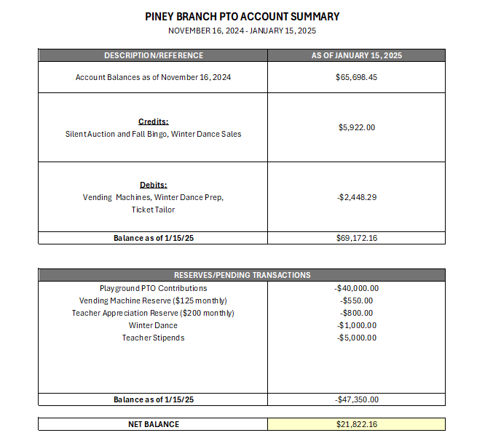
Financial Review

Slide 19
Open Questions & Discussion Time

Slide 20
Motion to Close

Slide 21
Contact Us
EMAIL ADDRESS
pineybranchpto@gmail.com
WEBSITE
https://pineybranchpto.com

