Slide 1
Piney Branch Elementary
PTO
MEETING
November 20, 2024

Slide 2
Motion to Open
October Meeting Minutes
Today's Agenda
Upcoming Events
Winter Spirit Night
Winter Dance & Events
Committee Updates
Staff Appreciation
Yearbooks
Wednesday, November 20, 2024
WATCH D.O.G.S.
Fundraising Goals
Financial Review
Open Questions & Discussion
Motion to Close

Slide 3
Motion to Open

Slide 4
Opening Remarks

Slide 5
October Meeting Minutes
Attendees: Sara Agne, Chris Gallegos, Stephanie Davis, Susie Bacus, Steve Thorne, Gigi Kay, Anna Tatman, Amber Merriman, Ivette Ornelas, Malia Hayes
Motion to Open - Sara seconded
Opening Remarks
Chris Gallegos
We had a successful movie night, over 300 attendees.
National Honors Society helped with concessions
Working with administration on fundraising goals
40 days into the school year, we will have discussions about what the school needs.
Spirit Wear Closed successfully on October 2nd.
Orders should be delivered within the next week.
If you ordered through the online store, you will get instructions on how to pick up the products by middle of next week.
Bingo Night will have a limited supply of extra inventory for sale.
Sponsored 2 Scholarship students with Baroody Enrichments - starting this week
There has been a lot of appreciation for these scholarship accounts that the PTO
September Meeting Minutes were approved.

Slide 6
October Meeting Minutes
Spirit Night
Haymarket Iceplex December 12th
Bingo
Tickets will be $1, concessions
Pizza and hot dogs
Tickets will be sold at the door for concessions
In front of the office - pre-paid section
Drinks on ice - 3pm
Chris and Amber will be here at 3pm to put drinks and food set up
Popcorn Machine - 30 minutes prior
Sign Up Genius for bingo callers - all times are covered
Snow Cone machine - messy but we have an industrial one we can use for the event.
Kindergarten would love to have the daubers that are leftover after Bingo night.
Stephanie will make the sign to collect daubers at the end of the night
Tablecloths for concessions - fabric black

Slide 7
October Meeting Minutes
Silent Auction
Tablecloths have been purchased and are ready.
How many tables do we need?
12 tables at receiving hallway
A lot of online bidding - it’s going great!
If you are present, you can take it home that night.
The only thing we won’t present at silent auction is the wine, that will need to be collected off school grounds.
Malia will add more lines to the ones that are full
Scholarship Students
Concession Tickets
40 Packs + 4 Daubers + Concession Tickets
Ivette to handle the scholarships
Special Seating to be reserved
4 seats will be reserved thus far.

Slide 8
October Meeting Minutes
Next Event will be Color Craze
T-shirt fundraising deadline ended this past week.
Last time we checked we have raised $16K, the goal is $20K
Fundraising will continue until October 31st.
Weather looks good in the extended forecast.
We will announce the overall classroom and individual winners the week following.
Color Craze timeline went out, Day 0 Encore schedule will be applied.
Volunteer sign up is available
Detailed day of coordination will be coming soon.
You will need a nametag and checked in to be at Color Craze running
Spectators will not need to check in with the office, you will be in a roped off area.
Check In might be remote outside instead of the office
Event Schedule, Additional Participant runners, available on the website.
They have to be pre-registered in order to participate
Participants that are not in the system will need to go through Raptor system
Newsletter specific to Color Craze - only is sent to PTO mailing list

Slide 9
October Meeting Minutes
Sara can send PDF of this newsletter to Ivette so it can go in the NEST or emailed out to general.
All proceeds go back to Piney Branch Elementary School.
Teacher appreciation
Beginning of November there will be a new appreciation
Ordered a new water machine for the teacher’s lounge, it gets here on Saturday and will be installed on Monday.
Yearbook
Candid Photography will be doing the yearbook this year, best deal with support from developers.
QR Codes will come to staff and teachers to collect
Software will recognize the students name so we can see all of the students
Hardcover yearbooks will be sold
Photographer?
Add photographer to the sign up genius
Reach out to PTO via the email
Candid did candid photos while they were here for picture day
They are local and willing to come to events to take pictures.

Slide 10
October Meeting Minutes
Committee Updates
Volunteer to Chair the Event: Jamie Whitaker
Sign up genius
Will need to develop a theme
Organizing it and promoting it, ticket sales.
We usually sell out of these tickets
We do have a fire code to adhere to so there will be a maximum number of tickets sold.
Watch DOGS
Everything is going great, sign ups are open
Facebook Page Promotions!
In addition to the Piney Branch parents page
160 members thus far, please share with everyone you know
Text Blast to go out to blast - in November

Slide 11
October Meeting Minutes
Fundraising Goals
Working with administration to finalize goals
Teacher stipends, need to know from teachers when they would like to
November/December Sandra purchasing
Stipends are really helpful, teachers are looking forward to this
Consensus
Looking at kindergarten playground that is more accessible
Equipment upgrades needed, PTO will tour with Mr. Thorne
14 Year inspection went well - budget is being discussed with Mr. Thorne
This will start in December
Ms. Evelyn has done a fantastic job keeping the building looking nice.
Financials
Credits
PTO Dues, Movie Night
Debits
Movie Night costs - Around $14k is the remaining balance.
PBAC is right after this meeting, encouraging everyone to attend.
Chris motioned to close.
Sara Agne Second the motion to close.
END MEETING-

Slide 12
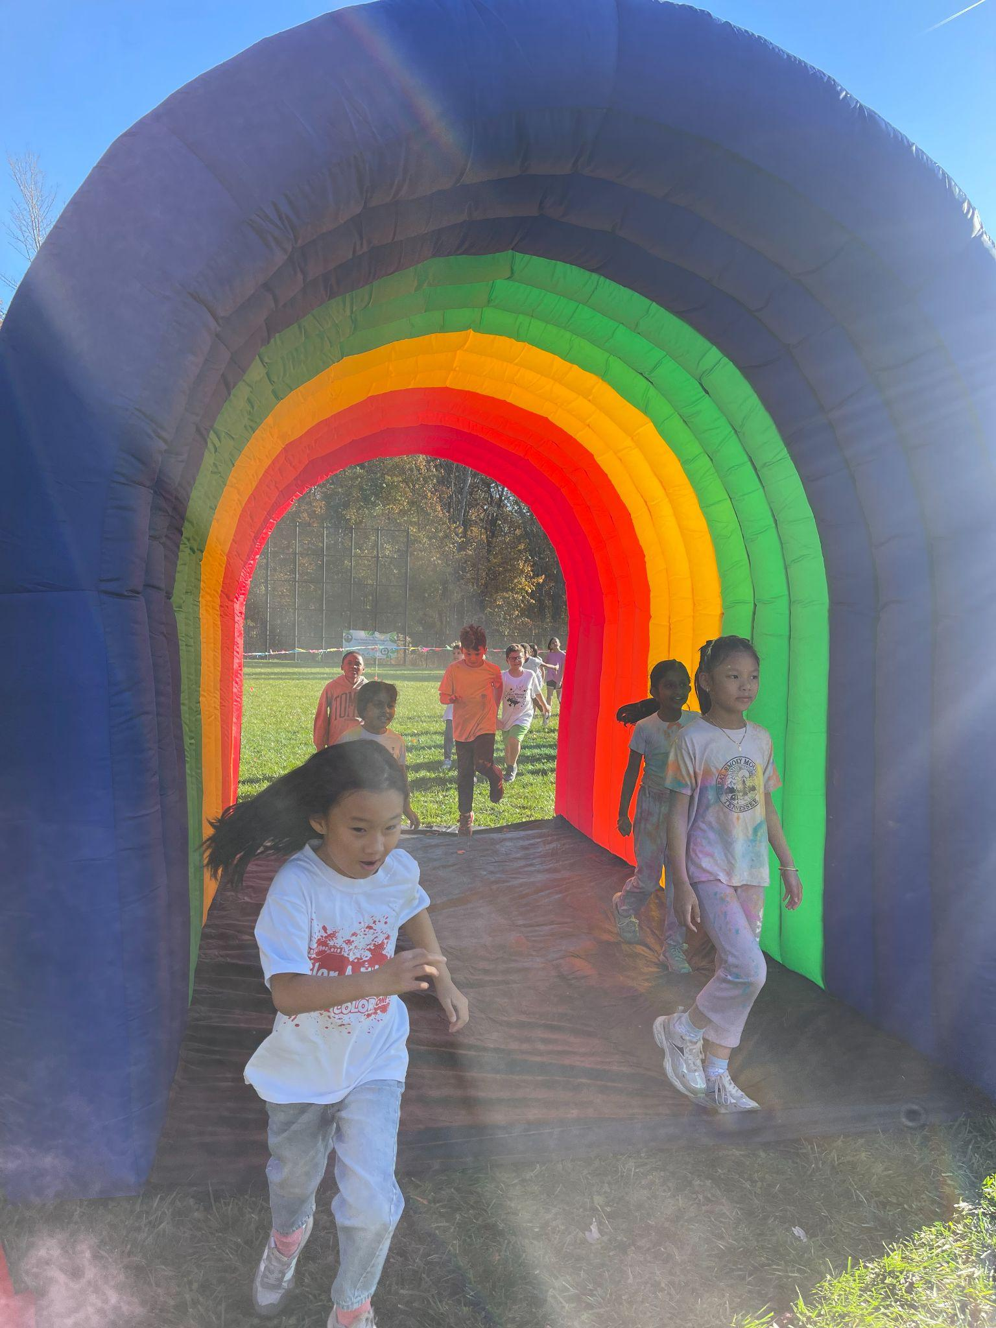
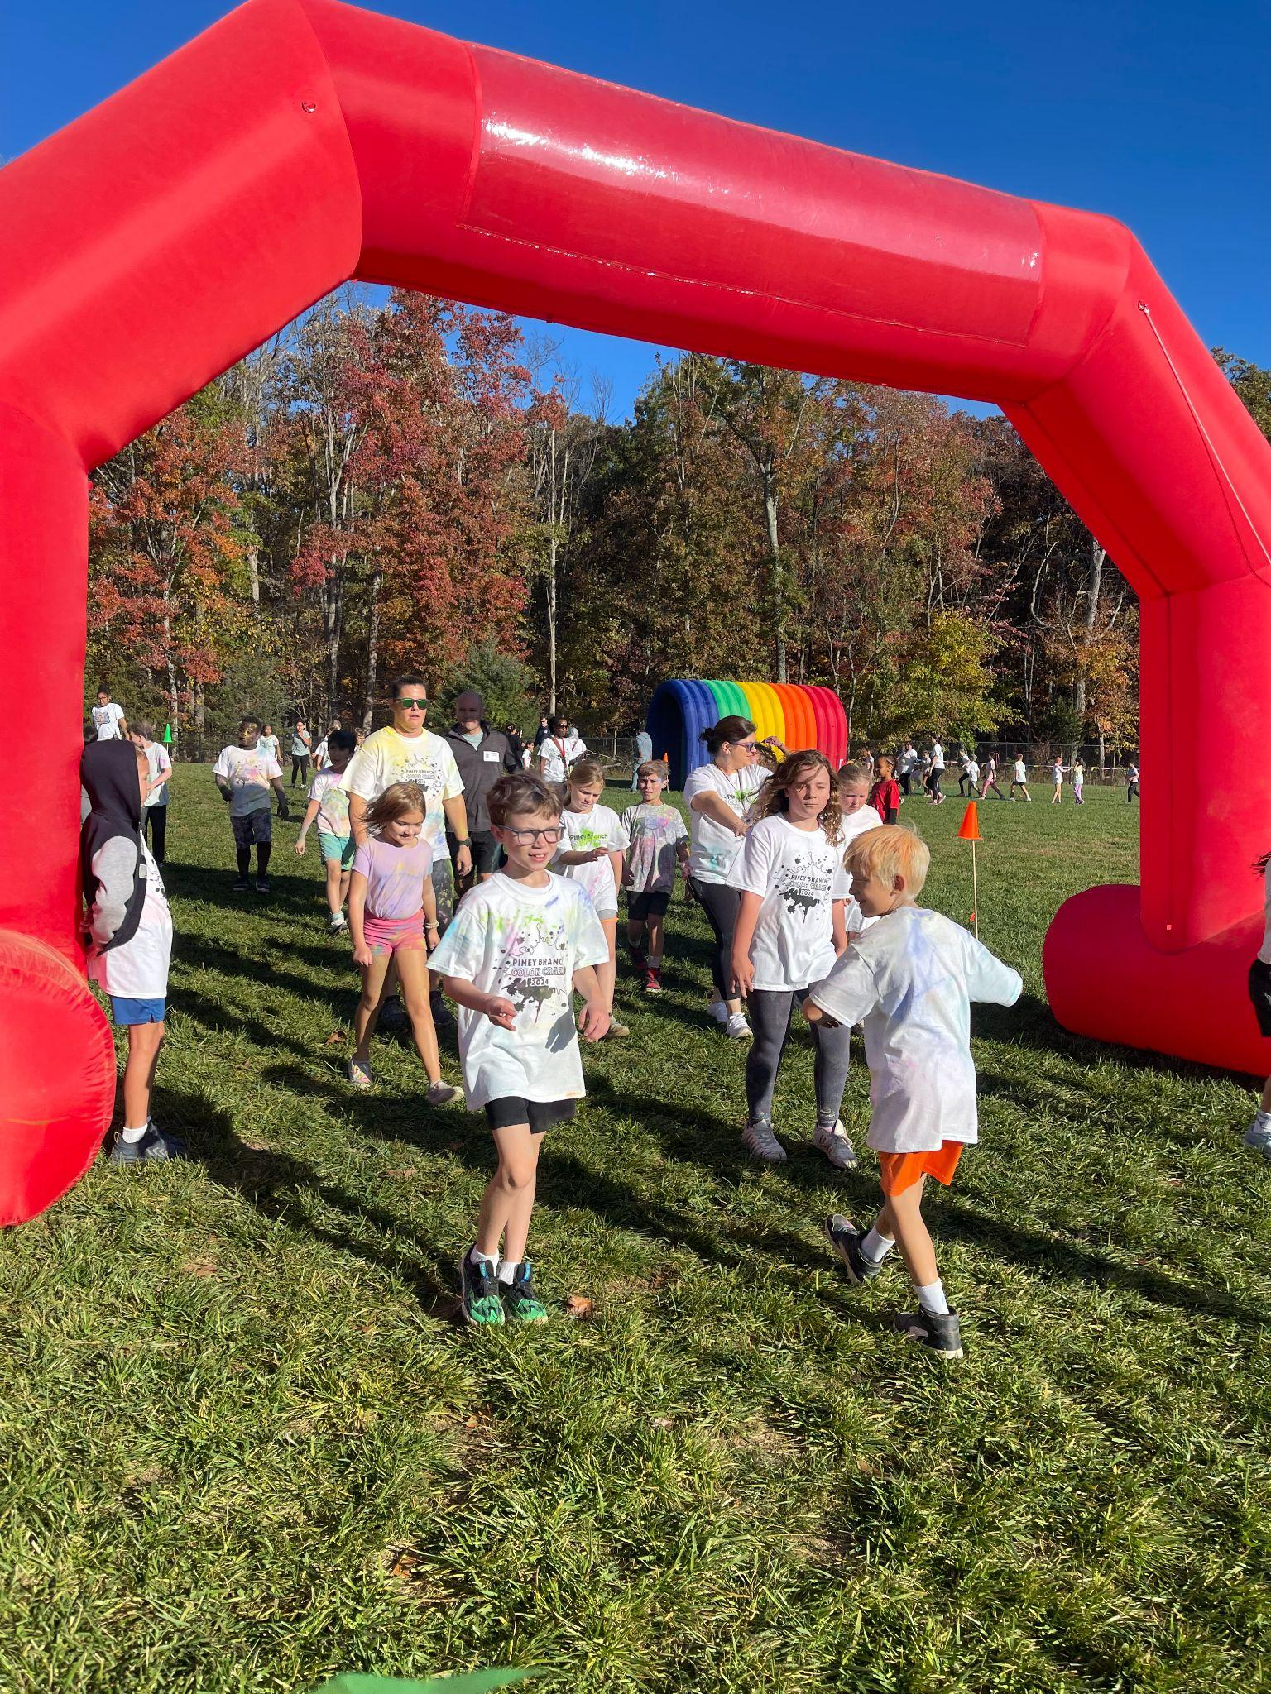
Color Craze Wrap Up
THANK YOU to everyone that made Color Craze a huge success!
211 fundraisers created
401 donations received
$17,521 donated
TOP EARNERS:
KG: Bella Gutierrez (Palmer)
1st: Dylyn Reynolds (Edwards)
2nd: Mackenzie Fenner (Cuffee)
3rd: Skylar Meyers (Bintz)
4th: Merna Ali (Brenneman)
5th: Lucas Diaz (Roehn)

Slide 13
Upcoming Events
Square 1 Art
Tomorrow - November 21st - is the last day to place Square 1 Art orders.
Orders can be placed using the personalized catalog that went home with your student - or -
Online by visiting Art Search and entering the required information.
The PTO earns a portion of the proceeds from your orders. Thank you for supporting the PTO!

Slide 14
Upcoming Events
Spirit Nights
Our winter Spirit Night is December 14, 2024 at the Haymarket Iceplex. Please present the flyer when you enter and the PBES PTO will earn a portion of your purchase.
It will be a fun night of ice skating!

Slide 15
Upcoming Events
Winter Dance : Jan 24
- Spring Bingo : Tentative March 21st
- Musical : Apr 3-5
- Heritage Night : Feb 19th
- 5th Grade Promotion Party : TBD May
- Spring Enrichments TBD
- End of Year Celebration TBD

Slide 16
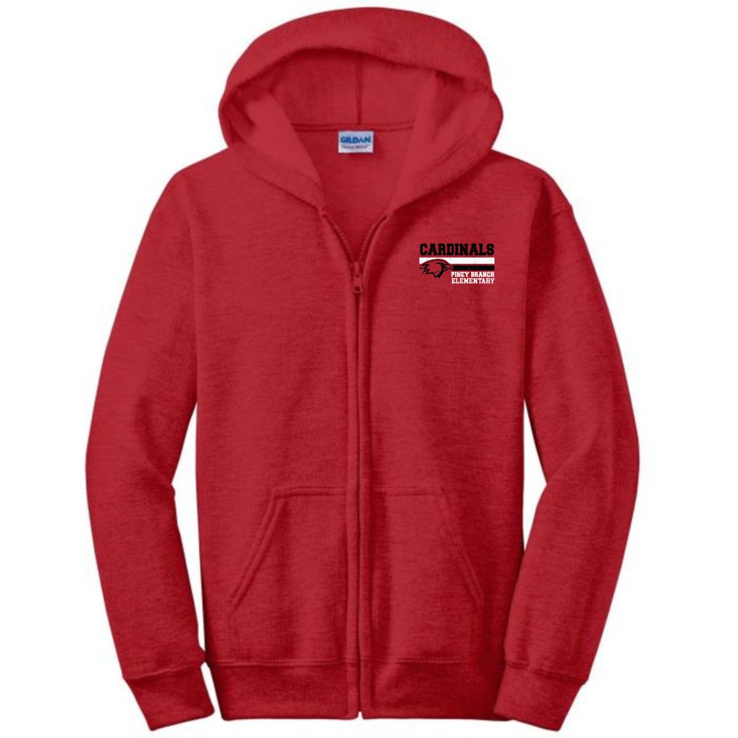
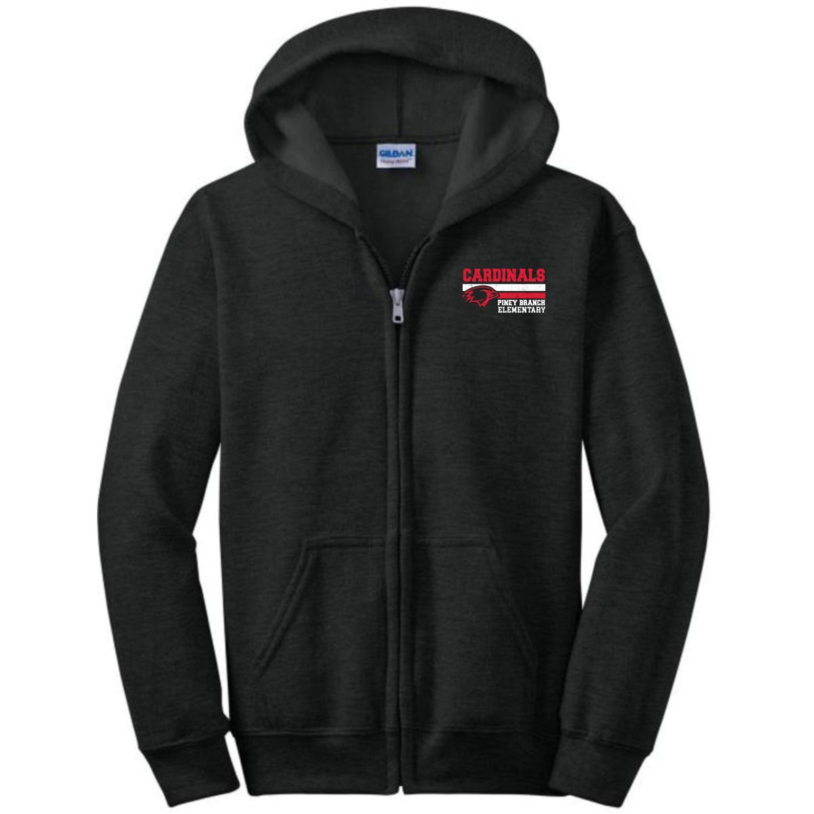
Spirit Wear Items Available

Slide 17
Committee Updates
Staff Appreciation
PBES Staff Appreciation Committee would like to stock the staff lounge with coffee, tea & hot cocoa supplies before Thanksgiving!
Please check out the Amazon Wish List on our Facebook page to see how you can help!

Slide 18
Committee Updates - Yearbook
Celina Gallegos will be spearheading the Yearbook committee this year.
If you would like to Volunteer, please email here:
yearbookpbes@gmail.com

Slide 19
Committee Updates - Winter Dance
Winter Dance Planning Committee is set and working to make this a spectacular event.
The dance will be CARNIVAL themed!
The Winter Dance is Friday, January 24th. Tickets will go on sale December 9th. More details to come soon!
Please remember, the Winter Dance is not a drop off event. Students must be accompanied by a parent/guardian. All attendees must have tickets.

Slide 20
Watch D.O.G.S.
WatchDOG dads and volunteers perform a variety of tasks during their volunteer day including monitoring the school entrance, assisting with unloading and loading of buses and cars, monitoring the lunch room, or helping in the classroom with a teacher’s guidance by working with small groups of students on homework, flashcards, or spelling.
Sign Ups through December.
New Dates will be released next month!
Mr. Jim (Security)
Ms. Ornelas (Parent Liaison)
Adam Bacus - Parent Lead
Brandon Merriman - Parent Lead

Slide 21
Find us on Facebook!
Piney Branch Elementary
School PTO Facebook Page
Please spread the word to all your
Piney Branch friends on Facebook!

Slide 22
Fundraising Goals
Ongoing initiatives:
Various Club T-shirts
Musical Scripts and Supplies
Staff Stipends
End of Year Celebration
Fun Assemblies
Monthly staff appreciation + Teacher Appreciation Week
Teacher Lounge Vending Machines
Various grade level requests (Scholastic, science supplies, etc.)

Slide 23
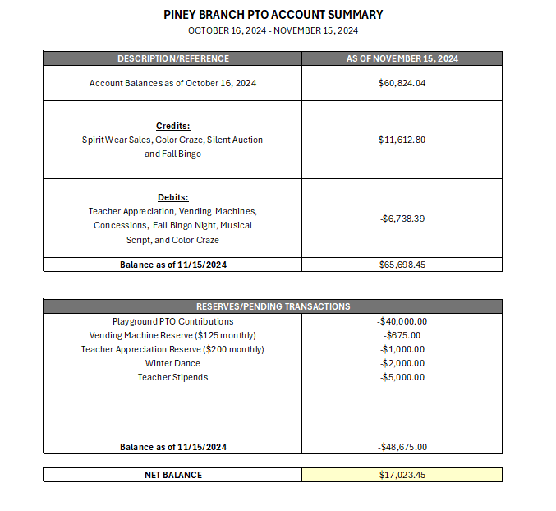
Financial Review

Slide 24
Open Questions & Discussion Time

Slide 25
Motion to Close

Slide 26
Contact Us
EMAIL ADDRESS
pineybranchpto@gmail.com
WEBSITE
https://pineybranchpto.com

