Slide 1

Piney Branch Elementary
PTO Meeting
March 18, 2026

Slide 2
Motion to Open

Slide 3
Agenda
Motion to Open
January Meeting Minutes
Upcoming Events
Committee Updates
Fundraising Goals
Financial Review
Open Questions & Discussion
Motion to Close

Slide 4
January 2026 Meeting Minutes

Slide 5
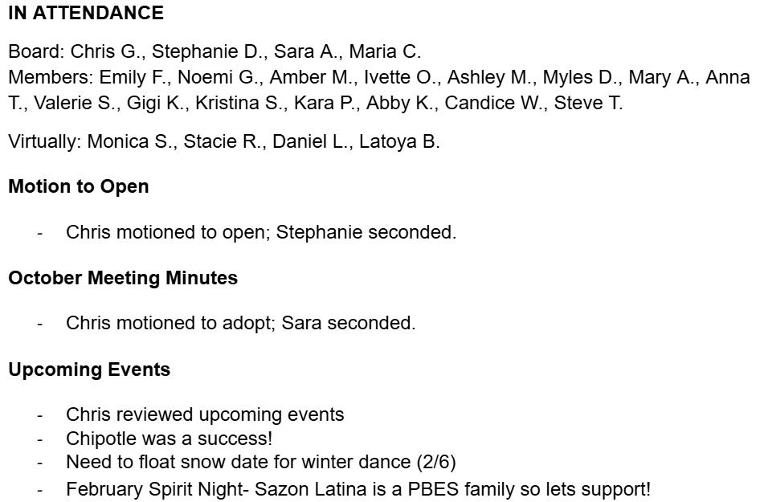
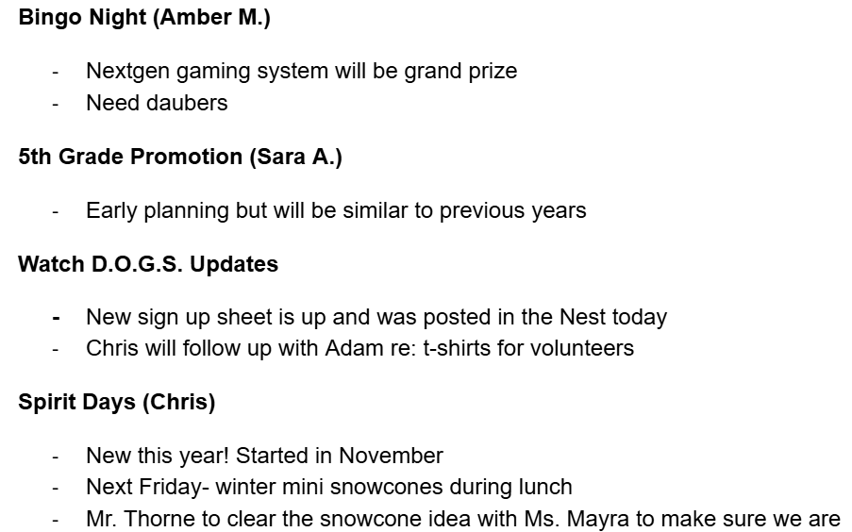
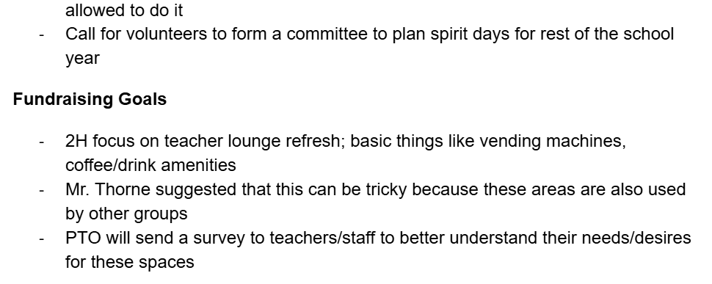
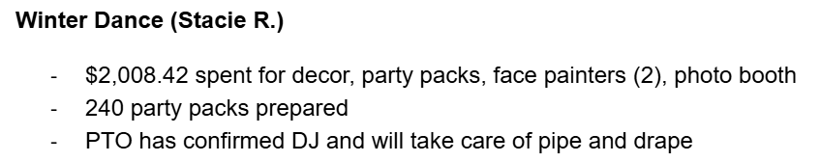
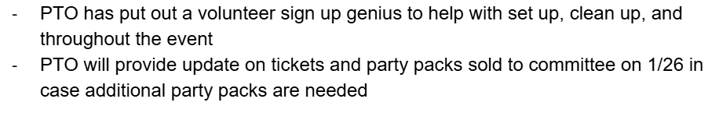
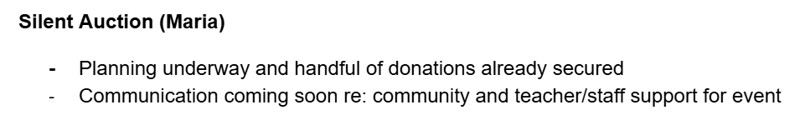
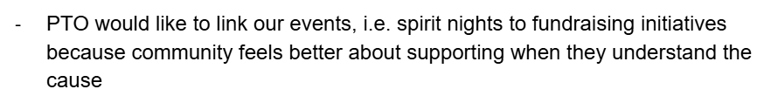

Slide 6
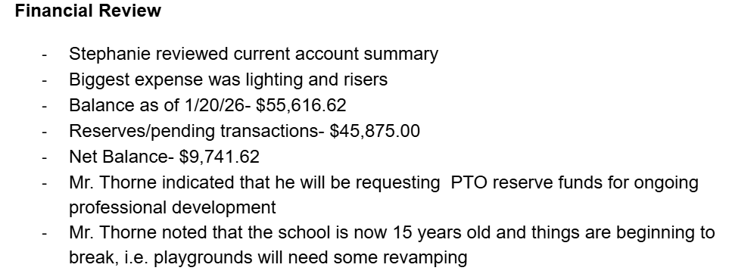
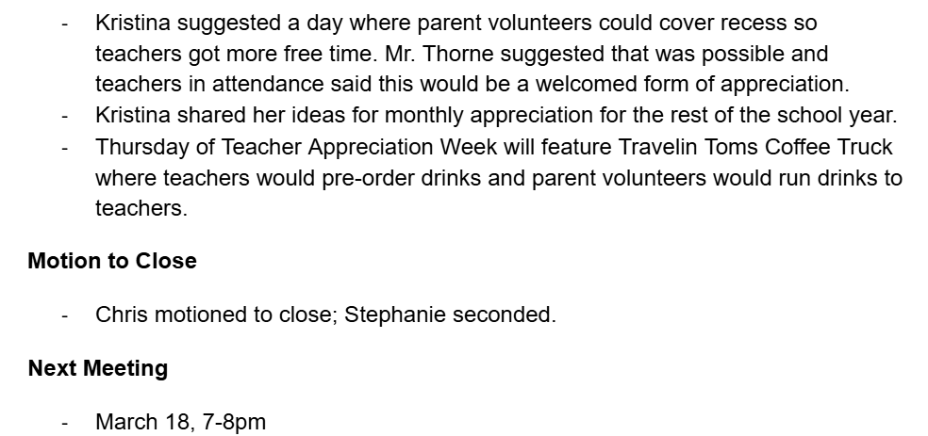
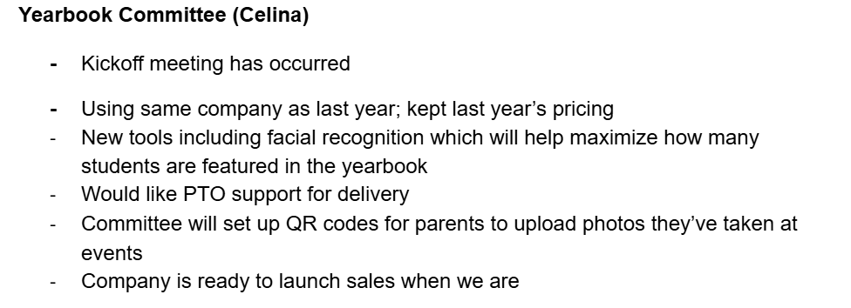
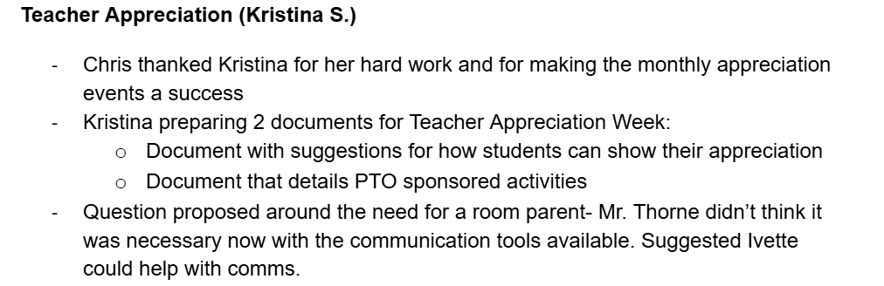

Slide 7


Upcoming Events
SEP - NOV
DEC - FEB
MAR - JUNE
Baroody Camp Registration
Spirit Night (Urban Air)
Fall Bingo + 50/50 Raffle - 10/24
Color Craze Run - 10/31
Square 1 Art Fundraiser
Spirit Night (Chipotle) - 12/3
Winter Dance - 2/6
Spirit Night (Sazon Latina) - 2/19
Finding Nemo Musical - 3/5-7
Spring Bingo + Silent Auction - 3/13
Heritage Night + PTO Passport Program - 4/10
Spirit Day - 4/24
Teacher Appreciation Week - 5/4-8
Movie Night - 6/5
5th Grade Promotion - 6/11

Slide 8
Committee Updates
Teacher Appreciation Committee - Kristina Stark
Yearbook Committee - Celina Gallegos
5th Grade Promotion - Lauren Main & Sara Agne
Watch D.O.G.S - Adam Bacus & Brandon Merriman
Spirit Days - Noemi Giragosian

Slide 9
Fundraising Goals & Initiatives
1H
Stage lighting & risers
STEAM Initiatives
Art Room Renovations
Teacher Stipends
2H
Teacher lounge refresh
Feedback from teachers will be solicited via survey in the upcoming weeks!
New Vending Machines

Slide 10
Board Elections: May 6, 2026
Open Position:
Member at Large
PTO Board Election Process
This years election will be held during the PTO Meeting on Wednesday, May 6, 2026 at 7pm in the Piney Branch Library. Interest form must be submitted by April 6, 2026: PBES PTO Website!
Member Voting Rights
Voting rights are only held by official PTO members. If you would like to vote, you must become a PTO member prior to April 30, 2026.

Slide 11
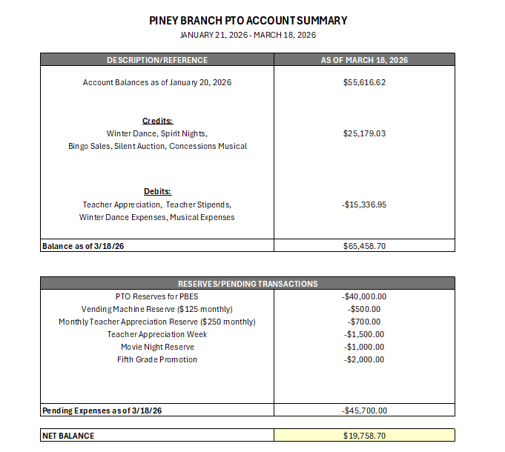
Financial Review

Slide 12

Open Questions &
Discussion

Slide 13
Motion to Close

Slide 14


Thank you!
Next Meeting: May 6, 2026
EMAIL ADDRESS
pineybranchpto@gmail.com
WEBSITE
https://pineybranchpto.com

